Slide 1

Your success is our success
Alternatives to Selenium
Funny Gorilla诙猩猩-IT培训

Slide 2
Agenda
Big Picture
How Selenium Works Logically
POM
XPath
How Selenium Works Physically
Selenium Test
Demo – Mouse Action

Slide 3
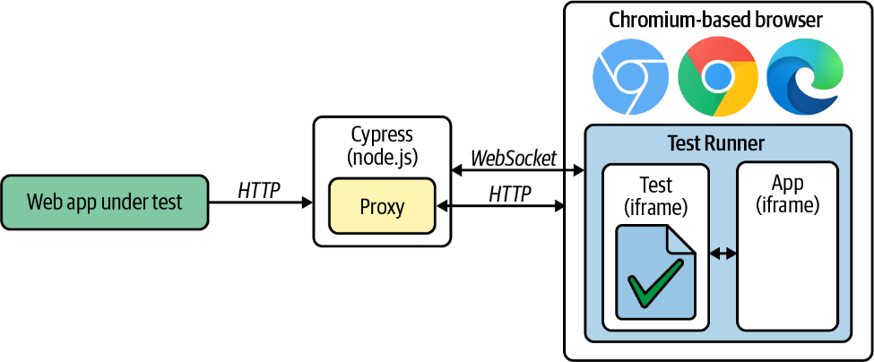
Cypress

Slide 4
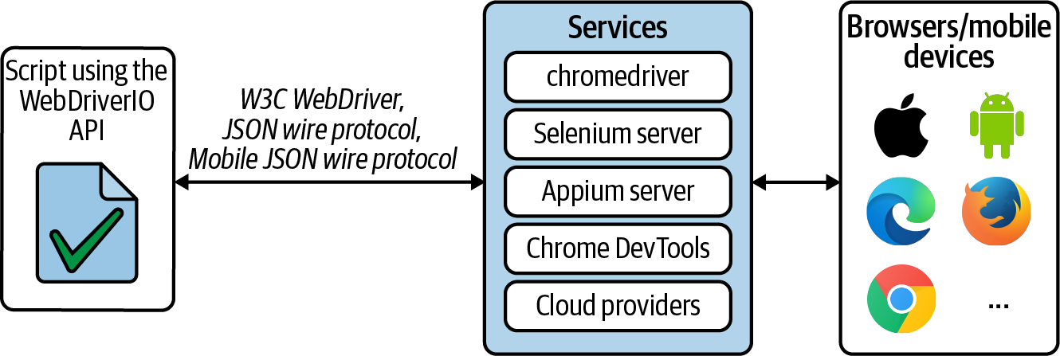
WebDriverIO

Slide 5
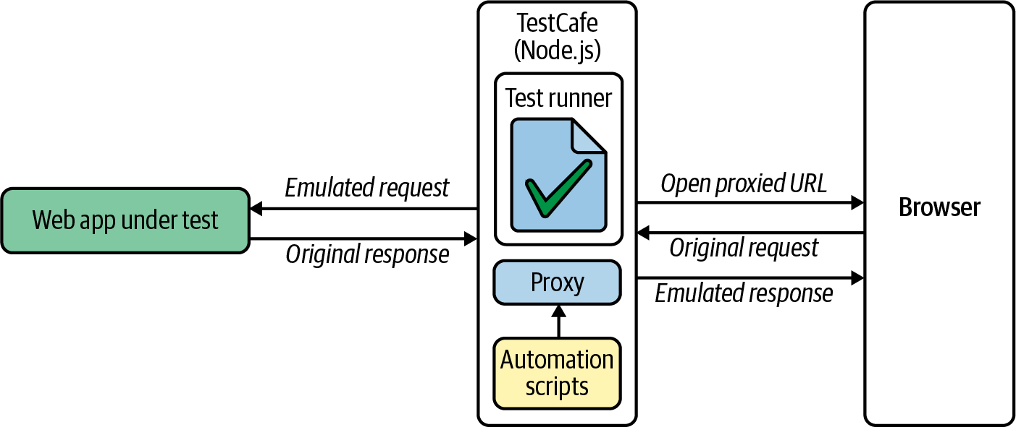
TestCafe

Slide 6
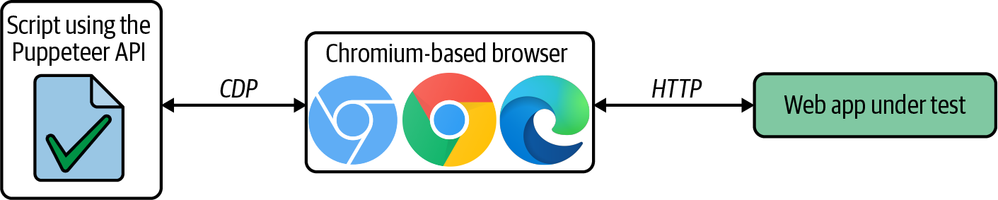
Puppeteer

Slide 7
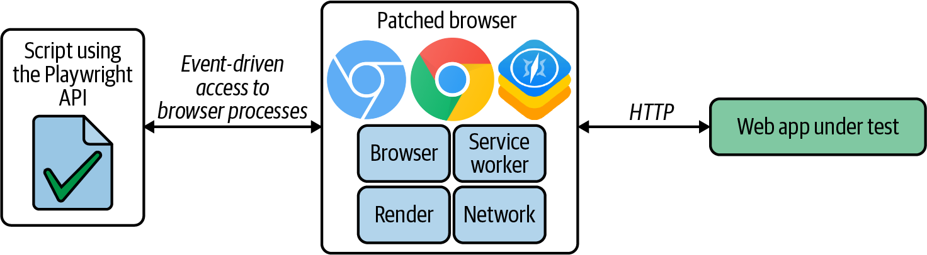
Playwright

Slide 8
References
Maven
Eclipse
https://www.vogella.com/tutorials/Eclipse/article.html
Java
XPath
https://www.guru99.com/xpath-selenium.html
Selenium tutorial
https://www.selenium.dev/documentation/webdriver/getting_started/
https://www.browserstack.com/guide/selenium-with-java-for-automated-test
https://www.tutorialspoint.com/selenium/selenium_webdriver.htm
https://www.lambdatest.com/blog/selenium-webdriver-tutorial-with-examples/
Code sample
https://www.lambdatest.com/blog/selenium-webdriver-tutorial-with-examples/

Slide 9
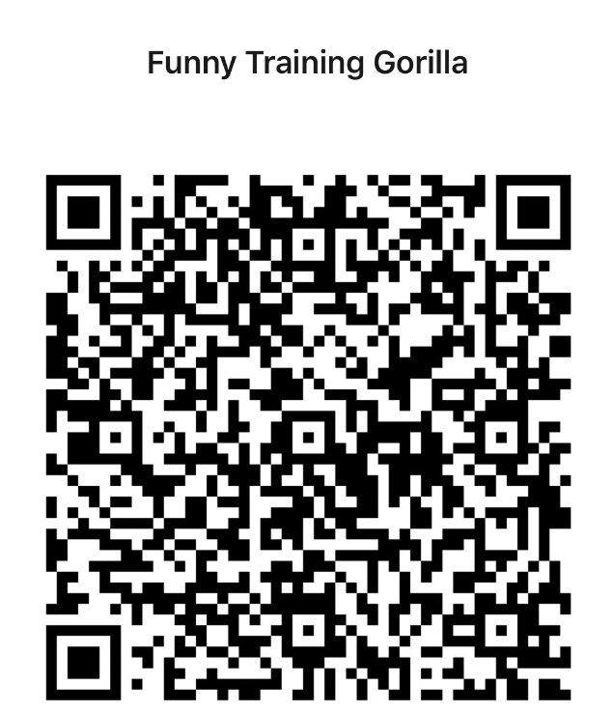
Contact
WebSite: www.funnygorilla.com.au
Mail: info@funnygorilla.com.au
Linkedin: https://mt.linkedin.com/in/songqing-gu-2ba9034b/de
WebChat: Funny Training Gorilla
Phone: 0420891343

